Slide 1
Synthesis writing
Writing a synthesis essay

Slide 2
What is synthesis?
A synthesis is a written discussion incorporating support from several sources of differing views. This type of writing requires that you examine a variety of sources and identify their relationship to your thesis.
It is a meaningful and insightful connection between different materials by the identification of common themes or traits.

Slide 3
It is a paper that uses several sources. The student’s goal is to soak up the data and formulate own theory, idea, or hypothesis.

Slide 4
It’s the creation of knowledge not the summarization!
a synthesis essay is to create new knowledge out of existing knowledge and sources.
To combine sources and the writer’s position to form a cohesive supported argument, accurately citing the sources.

Slide 5
Synthesis essay format is not that different from an argumentative paper as both use multiple sources to support one position. However, synthetic writing focuses more on the relationships between the references than on making a point. In this aspect, it is closer to a compare and contrast paper.
It is nothing like a reflective or narrative paper, so first-person writing and subjective opinion are not acceptable.

Slide 6
Types of Synthesis Essay
Explanatory synthesis helps readers make sense of a complicated topic. You don’t have to argue a point, just present facts, data, and different perspectives. This type of synthetic writing is common for research papers and scientific articles. Literature review or background sections use explanatory synthesis.
Argumentative synthesis supports a controversial position based on the data presented across a variety of sources. It’s an argumentative paper with a twist. Aside from listing critical points, you need to consider the relationship between references, especially if the authors support opposing views.

Slide 7
A review synthesis paper is a summary of research whose goal is to discover previous findings on the topic. Instead of proving your point based on the sources, you simply examine the ideas presented in those topics. As a rule, a synthesis essay thesis in such a case may simply state that the issue has not been properly discussed yet and requires more research.

Slide 8
Where synthesis is used?
Analysis papers to examine related theories.
Research papers to incorporate multiple sources.
Argument papers to compare differing views and support a coherent claim.
Business reports to examine differing ideas and blend into a coherent plan.

Slide 9
Before Writing Your Synthesis, do the following:
Narrow your topic
Summarize briefly common themes or traits in texts
Narrow your topic
Organize your research

Slide 10
Narrow Your Topic: it is often best to choose a specific focused topic. For example, the broad topic of the individual in conflict with society would need to be narrowed to something more specific such to how characters isolate themselves when confronting society’s injustices and prejudices.
Summarize Briefly Common Themes or Traits in Texts: : It is often best before you start to write to try to clearly define the themes or traits that the texts have in common.
Develop a working thesis statement: A working thesis statement should include a rough idea of your topic and the important point you want to make about that topic. Writing this statement at the top of a rough draft or outline and looking at it often can help you remain focused throughout the essay.

Slide 11
Decide how you will use your sources: After completing your research and gathering sources, you may have a large or overwhelming amount of information. However, the purpose of a synthesis essay is to use only the most important parts of your research, the information that will best support your claim.
Organize your research: Now, decide the order in which you will present your evidence, the various arguments you will employ, and how you will convince your readers.

Slide 12
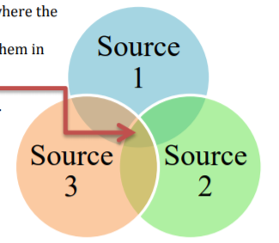
Key Features of a Synthesis
It is organized in such a way that readers can immediately see where the information from the sources overlap
It makes sense of the sources and helps the reader understand them in greater depth.
It zeroes in on the greatest points of convergence to show the strongest connections and most significant points of divergence.
It has a very strong and focused thesis statement that presents the writer’s point of view. It shows that the writer has a very detailed understanding of the sources and demonstrates a unique perspective or argument.

Slide 13
Strong synthesis essay provides
A strong and supportable thesis: This is a sentence provides your reader with a position/viewpoint that is logical and can be fully supported by the reference literature and your understanding, interpretation, and insight into the material.
A depth of discussion and effectiveness of argument: By using both indirect and direct reference to the text(s), a clear insight is provided that effectively supports your thesis
A strong conclusion: All your evidence and explanations should build toward a strong ending in which you summarize your view in a clear and memorable way. The conclusion in an expository synthesis essay echoes the introduction and fully reminds the reader of thesis and your insight.

Slide 14
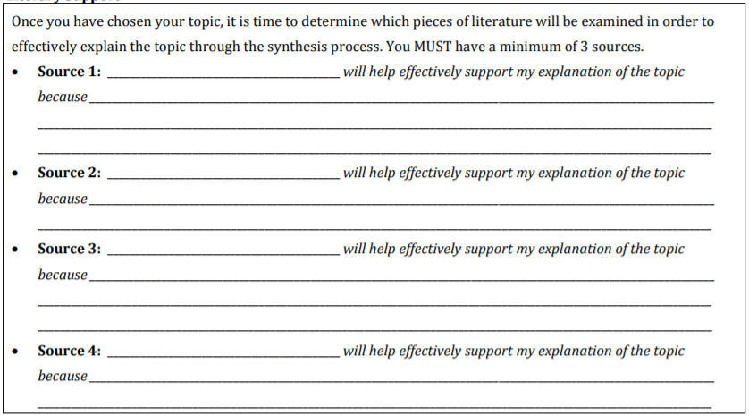
Outline your findings

Slide 15
As you read sources, jot down a few lines summarizing your takeaways
What conclusions can you draw?
Which side of argument does this source add to?
Some sources will be pictures/graphs: what can you take from them?

Slide 16
Step One: Before Writing
Collect your sources on the topic
Familiarize yourself with what others have written about the topic
Write a brief summary of each of your sources
Examine the evidence that other writers have used to support or to argue against the issue
Formulate your own thesis, after reflecting on your research

Slide 17
Step Two: Pre-Write
Read all the documents and note the following:
The title, author, and publishing information (for citing)
The position of the source on the topic (neutral, positive, or negative)
The summary of the source’s main idea
Two or more direct quotes to use as supporting evidence (with page numbers)

Slide 18
Step Two: Pre-Write
Using your thesis as a starting point, free-write, brainstorm, question or map out ideas on the topic
Using the pre-writing material you generate, create a scratch outline
Note: It is ALWAYS wise to create a short scratch outline for your essays. However, for synthesis essays, this step is essential if you are to clearly and logically organize your multiple sources

Slide 19
Sample scratch outline for a synthesis essay
Thesis: The two memoirs, All Over but the Shoutin’ by Rick Bragg and The Color of Water by James McBride, share the theme that, with familial support and love, we can overcome obstacles
Supporting Point 1: In All Over but the Shoutin’, Rick Bragg’s mother teaches him to persevere in difficult circumstances
Supporting Point 2 (with transition): Like Bragg, in The Color of Water, James McBride’s strong mother instills in him the importance of education as a path out of poverty

Slide 20
Do I Need a Thesis Statement?
Thesis statement is the core of your essay.
Fully address the complexity of the problem. This means that your thesis should encompass all the crucial points of the topic.
Express your firm position. This applies to argumentative essays, not the explanatory ones. Do not try to play it safe. The professor will not grade your opinion, only your writing.
Provide organizational patterns for the essay. You can’t squeeze the whole paper into a single sentence, but you can list the main points and possible counterarguments, turning the thesis into a mini-outline.

Slide 21
Step Three: Write
For each of your supporting points, write a complete sentence; use these as the topic sentences for all of your body paragraphs
Using the topic sentences and your scratch outline, write the essay
Using the summaries you wrote for each of your sources (see Step One), add these quotations, facts and opinions to prove each of your key points
HINT: DO NOT include lengthy summaries of your sources in your essay but very brief summaries that support your thesis directly and clearly

Slide 22
Step Four: Revise
Be sure that your thesis covers all the supporting points
Be sure that you have introduced all of your sources in the introductory paragraph
Check that each body paragraph begins with a clear topic sentence to focus the main idea
Make sure that all of your evidence supports your thesis clearly; edit out any facts, quotes or ideas that do not (or move them to paragraphs where they logically belong)
Add quotations, facts or opinions of your sources where you are lacking adequate evidence
Be sure that you have introduced the writer of all quotations by putting the name of the writer in your text, right before the quote
(According to Smith,”XXXXX”)

Slide 23
Step Five: Edit
Add, delete or move ideas as needed
Proofread for grammar, mechanics, punctuation, word choice or typographical errors

Slide 24
Sample outline for a synthesis essay
A synthesis essay should be organized so that others can understand the sources and evaluate your comprehension of them and their presentation of specific data, themes, etc.
The introduction (first paragraph) 1. Thesis sentence that sums up the focus of your synthesis. 2. Also introduces the texts to be synthesized: (i) Gives the title of each source (following the citation guidelines of whatever style sheet you are using); (ii) Provides the name of each author; (ii) Sometimes also provides pertinent background information about the authors, about the texts to be summarized, or about the general topic from which the texts are drawn.
The body of a synthesis essay: Each paragraph should:
1. Start with a topic sentence; 2. Include information from more than one source; 3. Indicate the names of your sources; .
Conclusion. Write a concluding paragraph that restates your thesis in different words and summarizes themes you have found and the ways they connect to the overall topic.

